Slide 1

NETFLIX STOCK PREDICTION
BY
SRIYA GORREPATI

Slide 2
INTRODUCTION
This analysis is focused on predicting the stock prices of Netflix using Machine Learning Models Arima, LSTM and Random forest.
many organizations and individuals have started using Machine Learning to predict stock prices using historical data to make better decisions in context to investments.
In addition to this ARIMA model, Random Forest Regressor and LSTM (Long Short Term Memory) has been implemented to compare and evaluate the performance of the three models with respect to the performance and accuracy of all the three models making predictions on the Netflix Stock Price dataset.

Slide 3
METHODOLOGY
The methodology selected is quantitative methodology.
Following are the steps that have been performed,
Importing the required libraries: pandas, seaborn, etc which will be used throughout the experimental analysis.
Data Cleaning: checking the null and duplicate values and handling them in order to perform the data analysis process.
Exploratory Analysis: in order to understand the data in a better way and also understand the statistical characteristics of the dataset.
Model Building: All three models will be trained using the training subset of the data and will be later on validated using the testing subset of the data.
Once all the models are trained and tested, evaluation will be made based on the accuracy score and mean absolute error values.

Slide 4
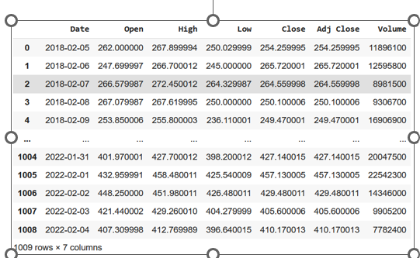
Experimental Analysis
Pandas has been imported for performing data manipulation operations and numpy has been imported to perform numerical operations on the dataset.
There are 7 columns in the dataset and these are
date(shows the date on which the price was recorded)
open(opening price of the stock), high(highest price touched by the stock)
low(lowest price of the stock on the specific date), close(closing price of the stock)
adj close(adjustments made for the stock)
volume(volume of the stocks traded on the specific date).
The data frame is of the dimension 1009 rows and 7 columns.

Slide 5
DATA CLEANING
Once the dataset has been loaded, the dataset is checked for null values and missing values.
It is found that there are no null or duplicate values present.
After Data Cleaning, Exploratory Data Analysis(EDA) is performed on the dataset to understand the data and its statistical characteristics.

Slide 6
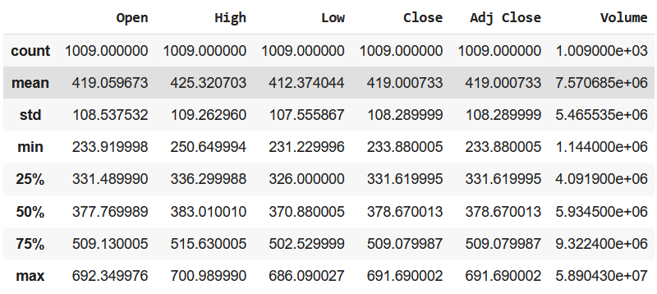
EXPLORATORY DATA ANALYSIS
From the statistical characteristics of the dataset, the mean, count, standard deviation, minimum and maximum, and quartile ranges can be estimated which will help in understanding the distribution of the data also.
“Adj Close” column is dropped as it is not relevant while performing the analysis and only other features will be used to make predictions.

Slide 7
VISUALIZATIONS
Average closing price with respect to each year. It can be seen that since 2018, the closing price has been constantly increasing an a slight decrease is seen in the year 2022.

Slide 8
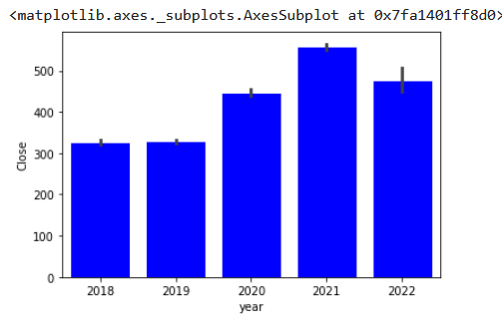

Slide 9
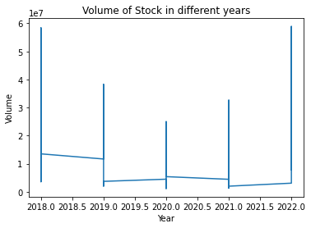

Slide 10
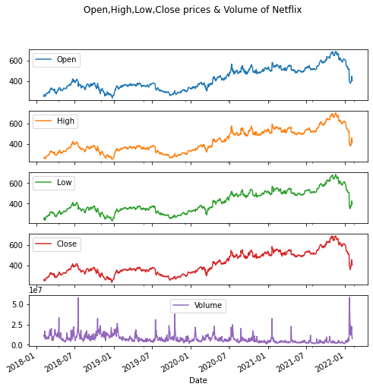

Slide 11
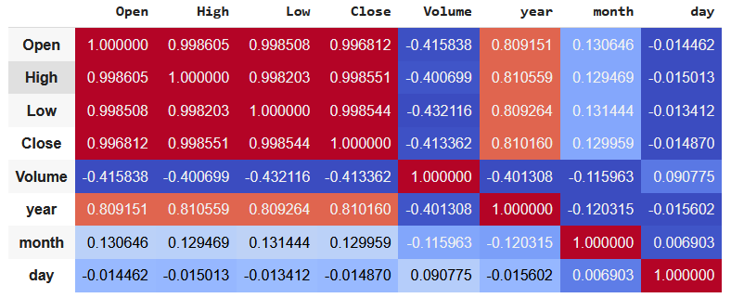
VISUALIZATIONS
Open and close attributes have a high correlation and open attribute also has a high correlation between years.
Helps in selecting the features while implementing the model.

Slide 12
MODEL BUILDING
Once all the models are trained and tested, evaluation will be made based on the accuracy score and mean absolute error values.
The target variable will be Closing price as it acts as the base for the last recorded price on a specific date.
This will be considered as a target variable.
the data is split into training and testing subsets where 30% of the data will be used to test the model and 70% of the data will be used to train the model.

Slide 13
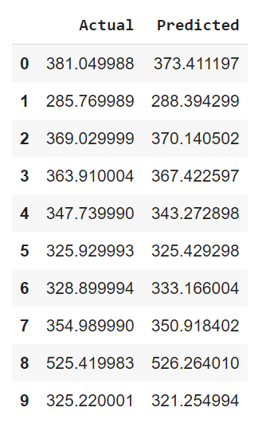

MODEL IMPLEMENTATION
Random Forest Model
The model is trained on the training data and will be tested using the test data.
After implementing the model, the root square error and accuracy score is calculated as shown.
The accuracy achieved by the Random Forest model is approximately 99%.
MSE is also predicted as an evaluation metric which is 21.24%.
A table has been created that shows the Actual vs Predicted values and it can be seen that the actual value in the dataset and the predicted value by the model is almost the same.

Slide 14
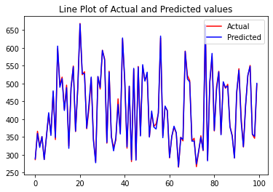

Slide 15
ARIMA MODEL
ARIMA model is one of the most widely used models and belongs to a class of models that ‘explains’ a given time series based on its own past values.
For the first 200 values, a graph has been plotted that shows the actual vs predicted values where the blue line represents the actual value of the dataset and red line represents the predicted value by the model.
Actual and predicted values are almost similar and overlap each other which means that the model is efficiently able to predict the NETFLIX stock prices.

Slide 16
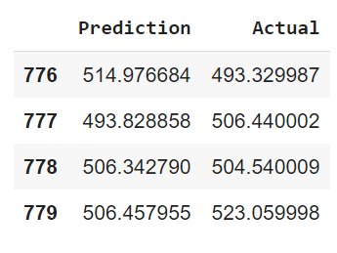

Slide 17
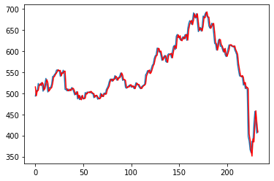
ARIMA MODEL PREDICTION

Slide 18

LSTM
Used to solve prediction tasks.
This works on the basis of a sequential model and different layers are added along with an optimizer to make predictions. Adam optimizer has been used in this model.
The RMSE of test data, test data Mean Absolute Error, MSE of Test data is derived and are having high values.

Slide 19
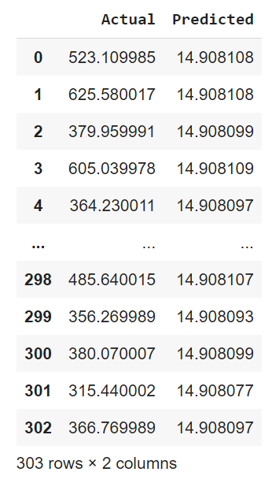

Slide 20
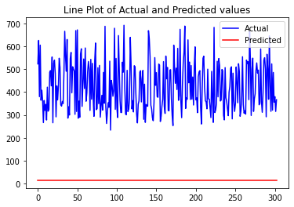

Slide 21
EVALUATION
Forest Regression is the best models when it comes to predicting the stock prices of Netflix.
Arima model is also showing high accuracy and prediction.
Whereas the LSTM model showed a high level of error which means that the model will not be able to efficiently predict the stock prices using the given data.

Slide 22
Thank You!

